Slide 1

Data Description
Session 4
M. Kachour

Slide 2
Numerical summaries of a variable
There are several indicators that summarize the data of a variable:
Position indicators
Dispersion indicators
Form indicators

Slide 3
Note

Slide 4
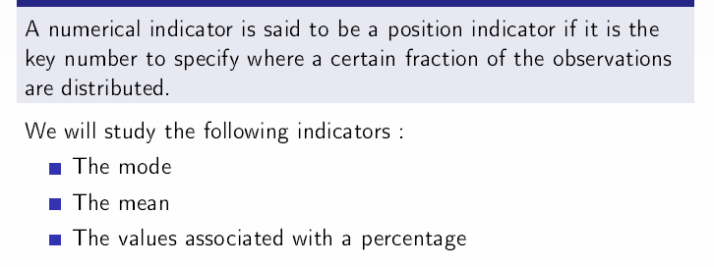
Position indicators

Slide 5
Note

Slide 6
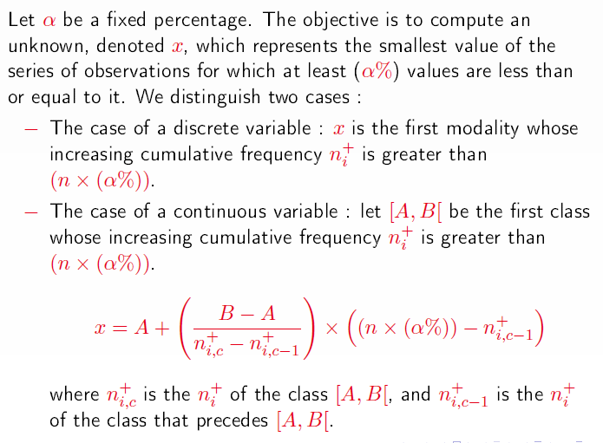
Position indicators – values relating to a percentage
These values can be calculated (using the same technique) when the data are ordinal qualitative variable.

Slide 7
Note

Slide 8
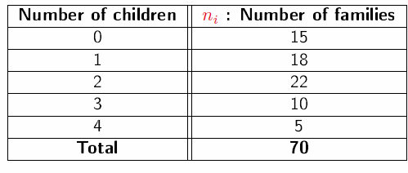
Examples – Calculating Quartiles
Example 1: The data below represent the distribution of 70 families in a village by number of children (under 18 years of age)
Calculate quartiles associated with the data.

Slide 9
Note

Slide 10
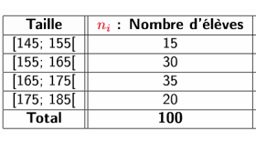
Examples – Calculating Quartiles
Example 2: The data below represents the height of 100 students/sports club members
Calculate quartiles associated with data.

Slide 11
Note

Slide 12
Note

Slide 13
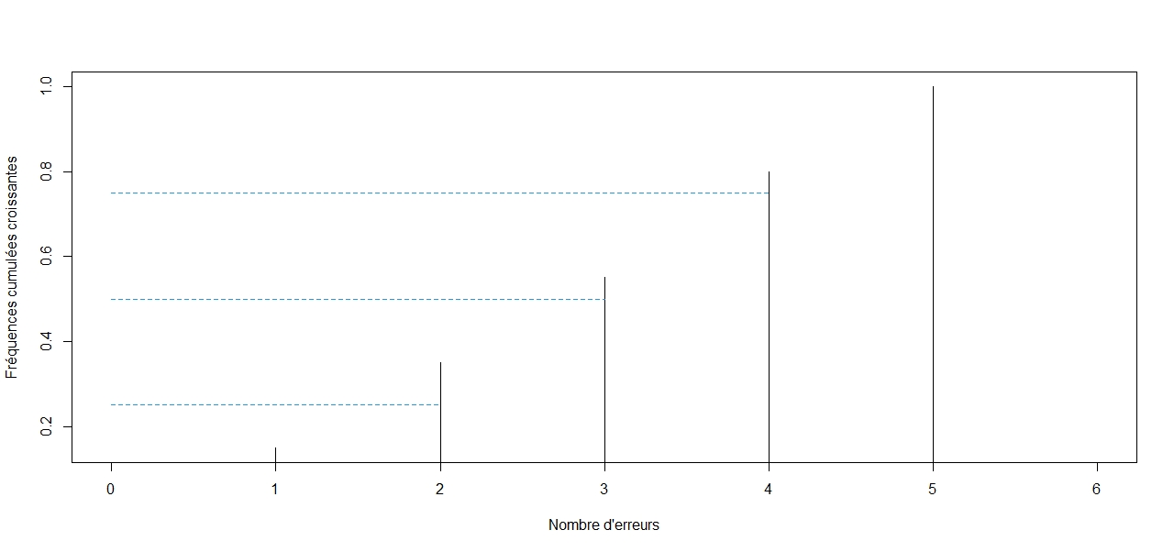
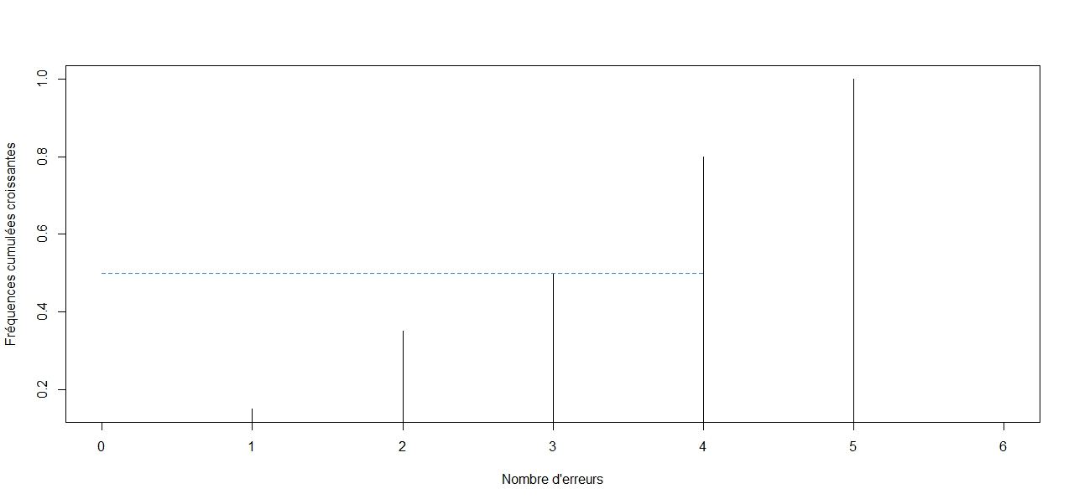
Values relating to a percentage– Graphically
Median

Slide 14
Note

Slide 15
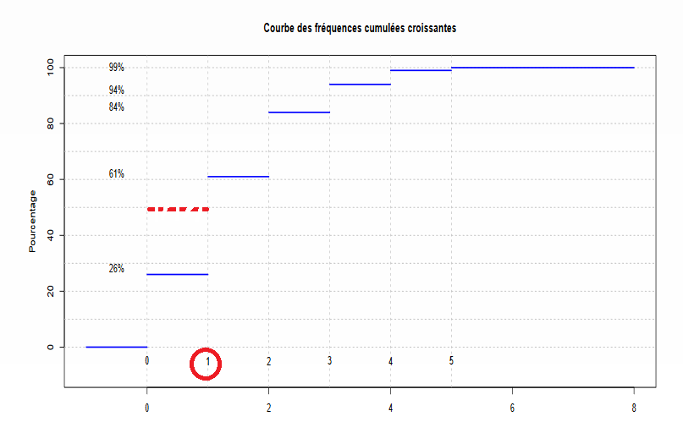
Values relating to a percentage– Graphically

Slide 16
Note

Slide 17
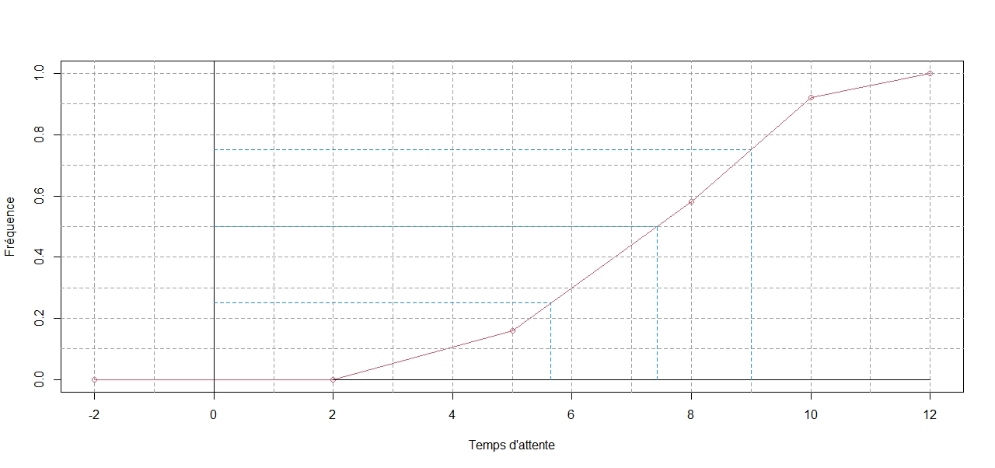
Values relating to a percentage– Graphically

Slide 18
Note

Slide 19
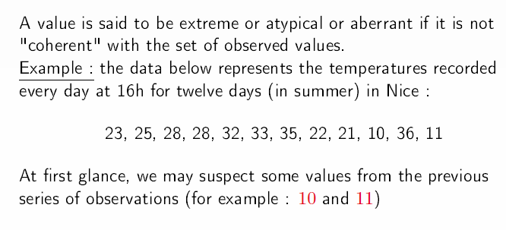
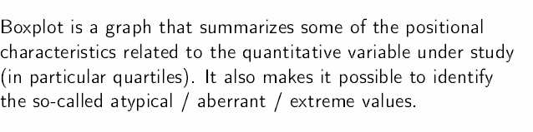
The box plot – detection of the existence of extreme values
This tool is not possible if the data are from a qualitative variable

Slide 20
Note

Slide 21
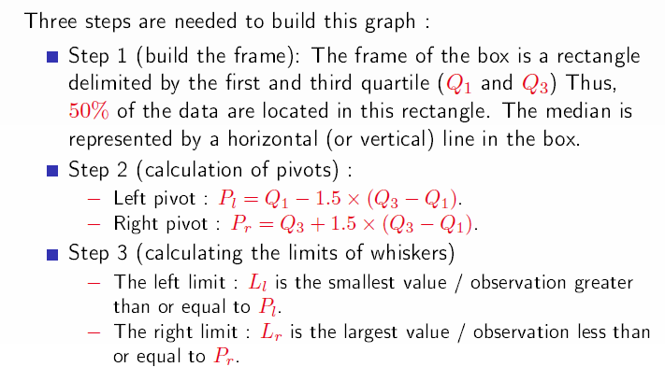
The box plot – construction

Slide 22
Note

Slide 23
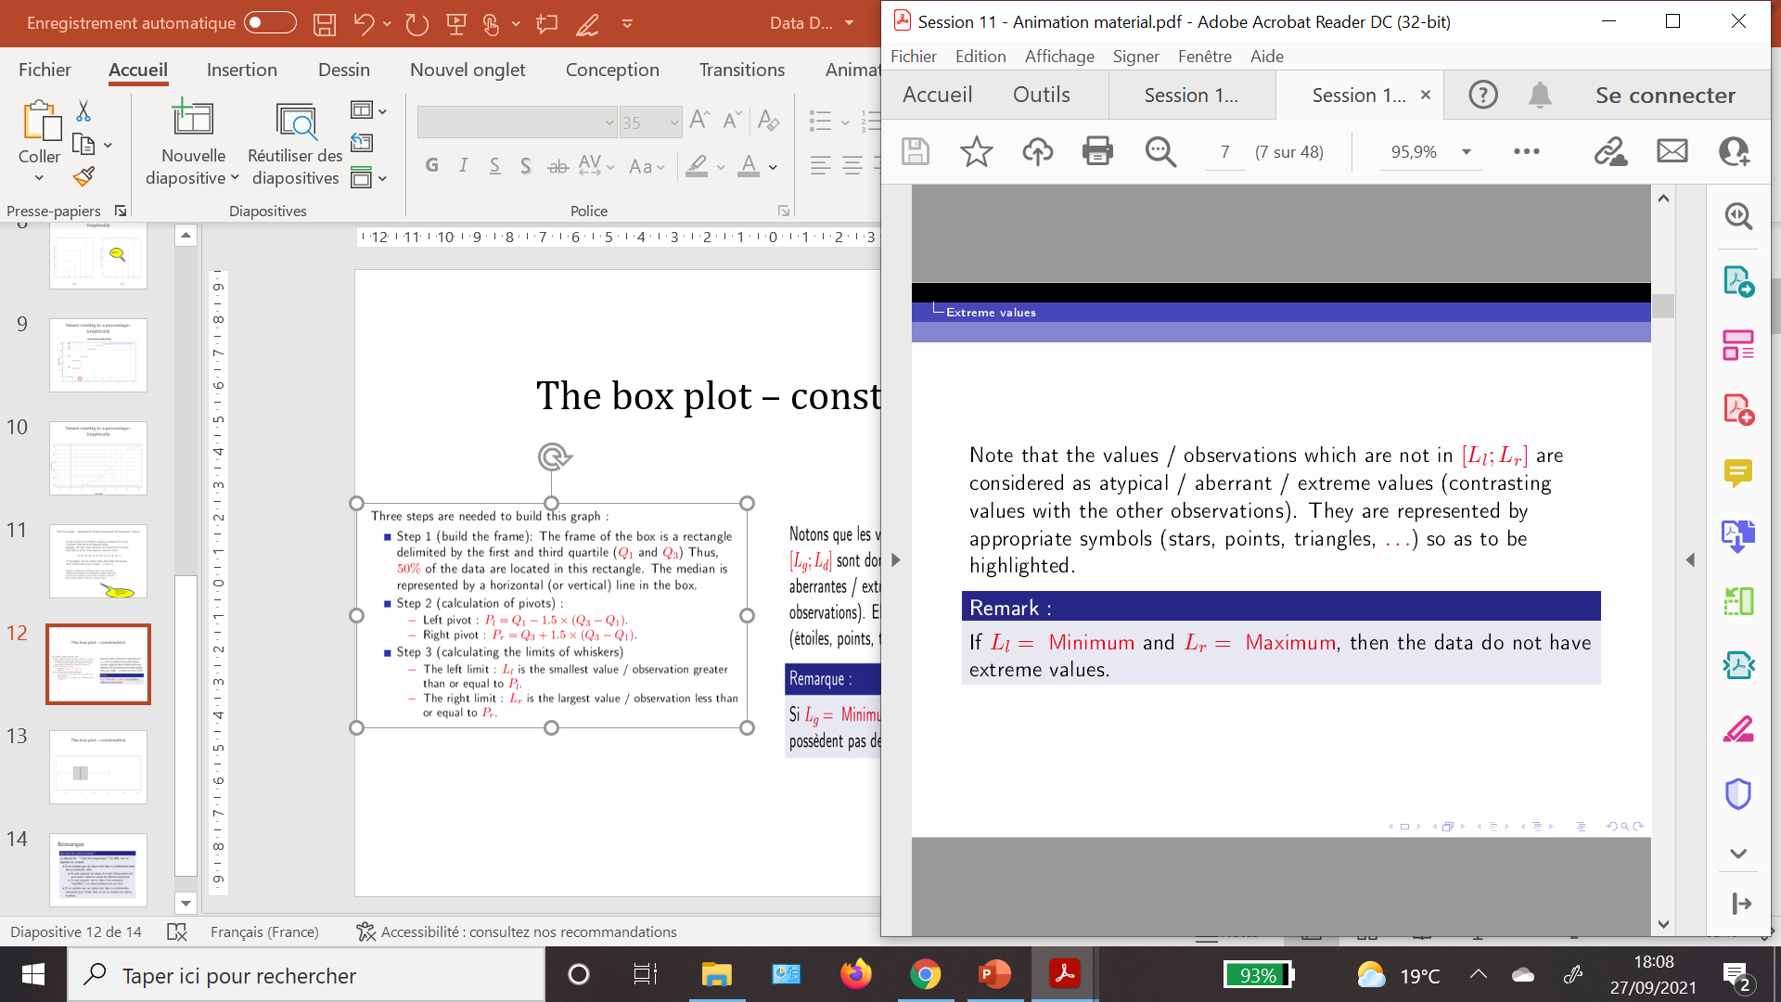
The box plot – construction

Slide 24
Note

Slide 25
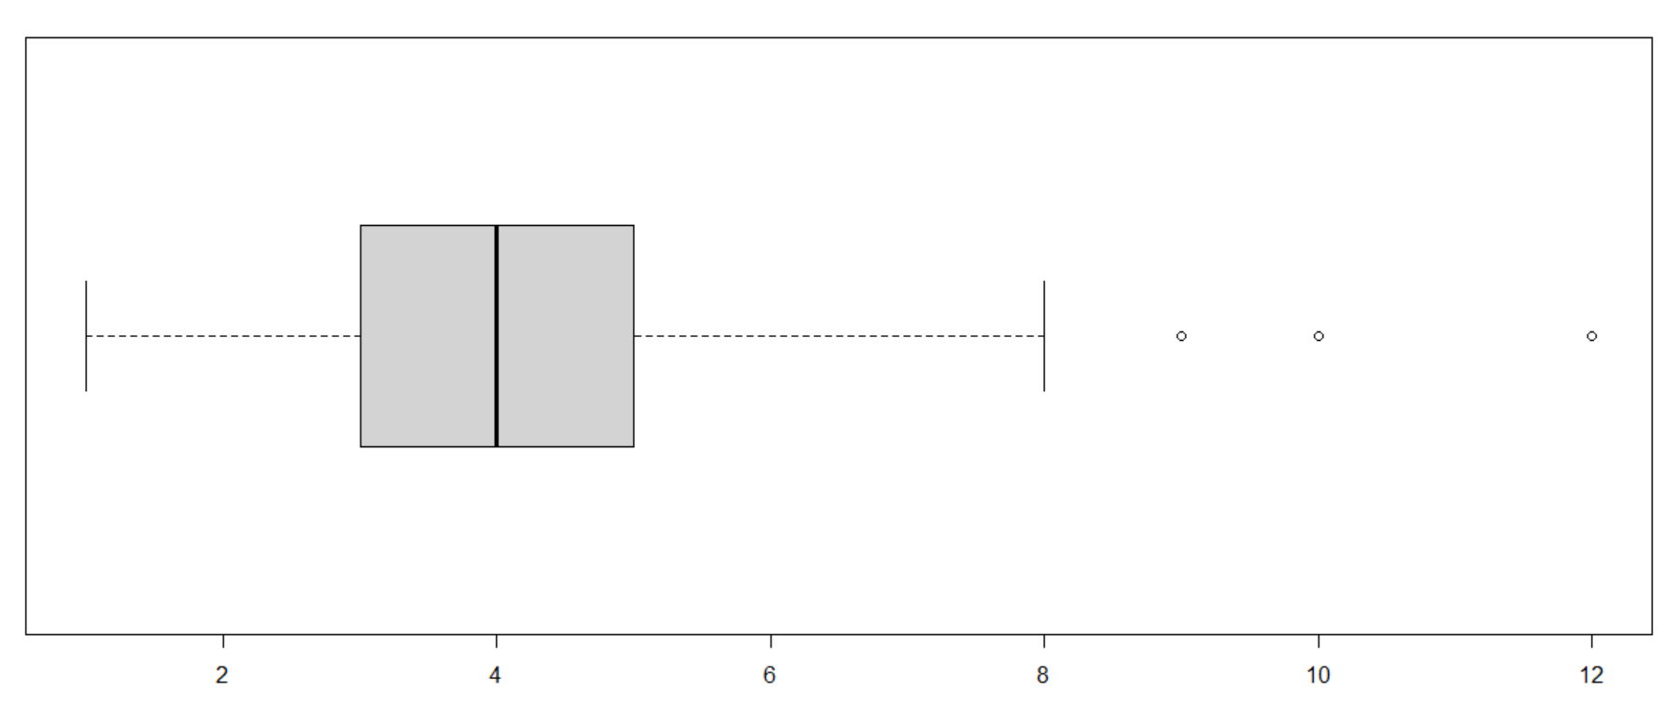
The box plot – construction

Slide 26
Note

Slide 27
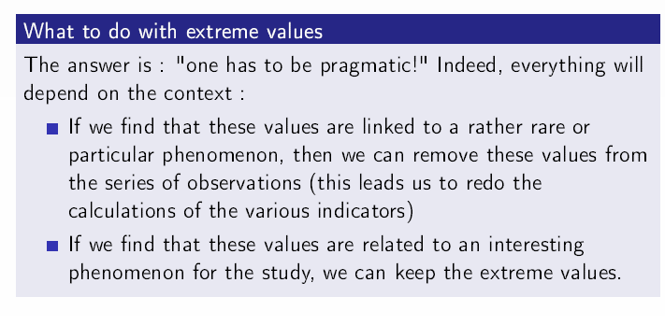
Remark

